Slide 1
Ignite UI for Angular Charts and Graphs

Slide 2
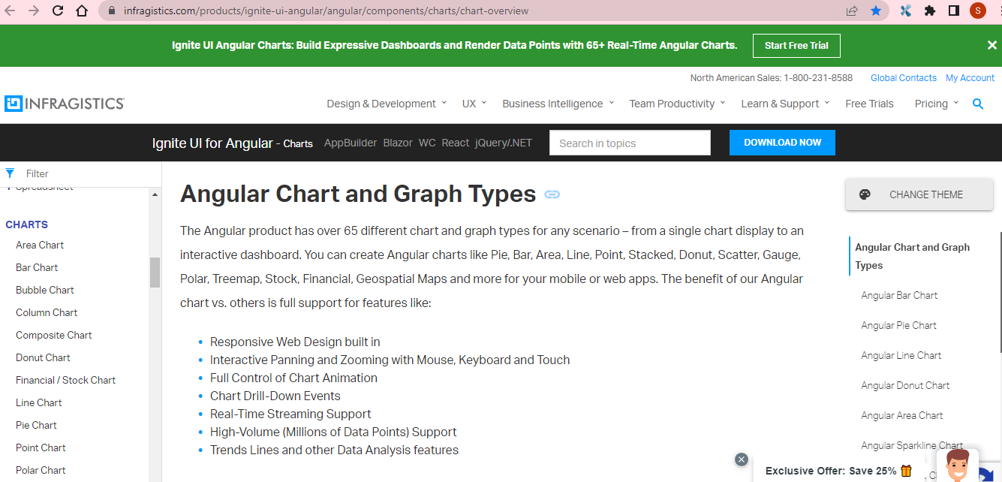
Reference: https://www.infragistics.com/products/ignite-ui-angular/angular/components/charts/chart-overview

Slide 3
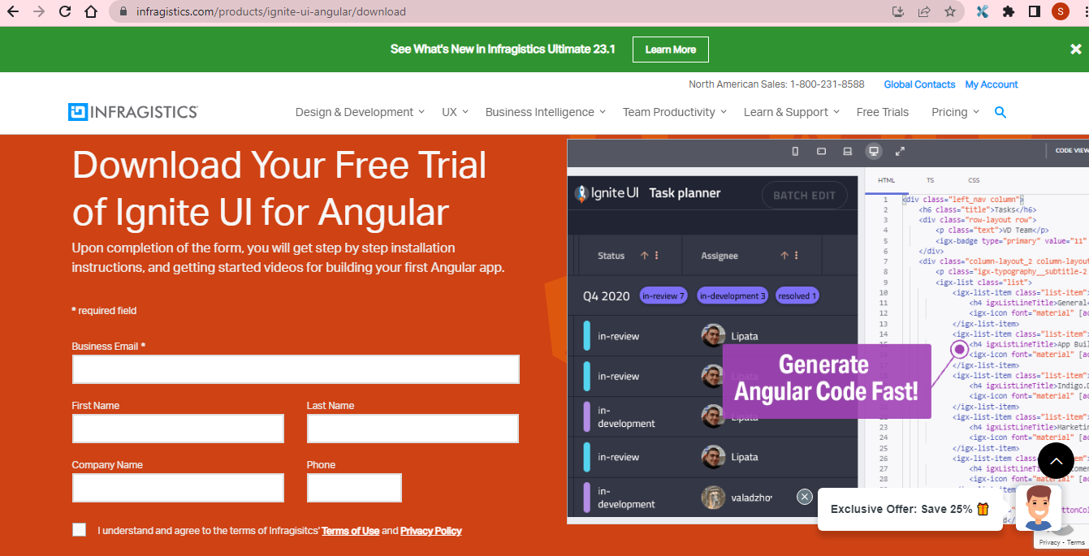

Slide 4


Ignite UI
Infragistics_Angular_v23-1Toolbar
igniteui-angular-examples-DV
samples
charts
category-chart
axis-options
Demo

Slide 5
Getting started with Ignite UI for Angular
Demo

Slide 6
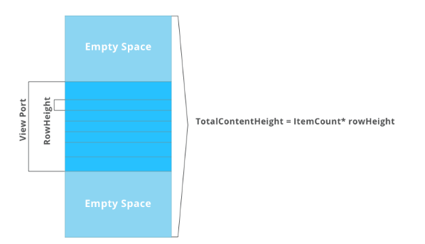
How to Load a Million+ Records in Less Than a Second in Syncfusion Angular Data Grid
Demo

Slide 7
Steps to load millions of records in Angular Data Grid
Step 1: Set up Angular environment.
Step 2: Create an Angular application.
Step 3: Add the Syncfusion grids package.
Step 4: Register Grid module.
Step 5: Add CSS reference.
Step 6: Add the Data Grid component.
Step 7: Bind 1 million generated data points to Data Grid.
Step 8: Module injection.
Step 9: Run the application
Demo

